Slide 1
Using A Standards Based Grading (SBG) System
Jennifer Griffin & Elizabeth Pate
South Central High School
Winterville, NC

Slide 2
Today’s Agenda:
Introductions
Writing meaningful standards
All about SBG
Examples
Try it Yourself

Slide 3
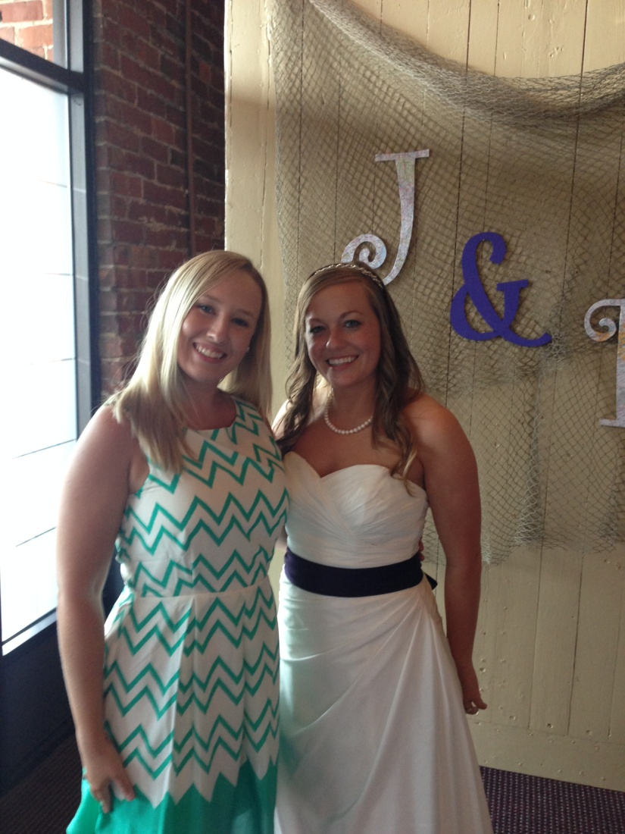
Who Are We?

Slide 4
What do grades often reflect? What should grades reflect?
Notes:
Whiteboard 3 mins

Slide 5
Writing Standards
NCES Phy.2.1.2
Compare the concepts of potential and kinetic energy and the conservation of total mechanical energy in the description of the motion of objects.

Slide 6
Writing Standards
Mrs. Pate’s Standards:
EM1 – I can use pie charts to represent the storage mechanisms of energy within a system.
EM2 – I can quantitatively solve for kinetic and potential energy or other variables.
EM3 – I can apply the conservation of energy to solve complex problems.

Slide 7
Let’s Write Your Own Standard

Slide 8
What is Standards Based Grading (SBG)?
Notes:
Mastery

Slide 9
Why Use Standards Based Grading?
Notes:
Pros
Data collection

Slide 10
Drawbacks of Standards Based Grading
Notes:
Cons
Time

Slide 11
How do I implement Standards Based Grading in my classroom?

Slide 12
Steps:
Gain administrative support.
Write a student/parent contact.
Divide content into small, student friendly objectives.
Organize assessments by standards.
Create multiple reassessments for each standard.
Decide what additional work is required for reassessment eligibility.
Give students opportunity to take reassessments.

Slide 13
Examples!!!!

Slide 14
Now You Try It!!!

Slide 15
Questions about Standards Based Grading?

Slide 16
Contact us!
We would be more than happy to answer any questions that you may have after today so please feel free to contact either of us!
Jennifer Griffin – griffinj1@pitt.k12.nc.us
Elizabeth Pate – patee@pitt.k12.nc.us

